Slide 1

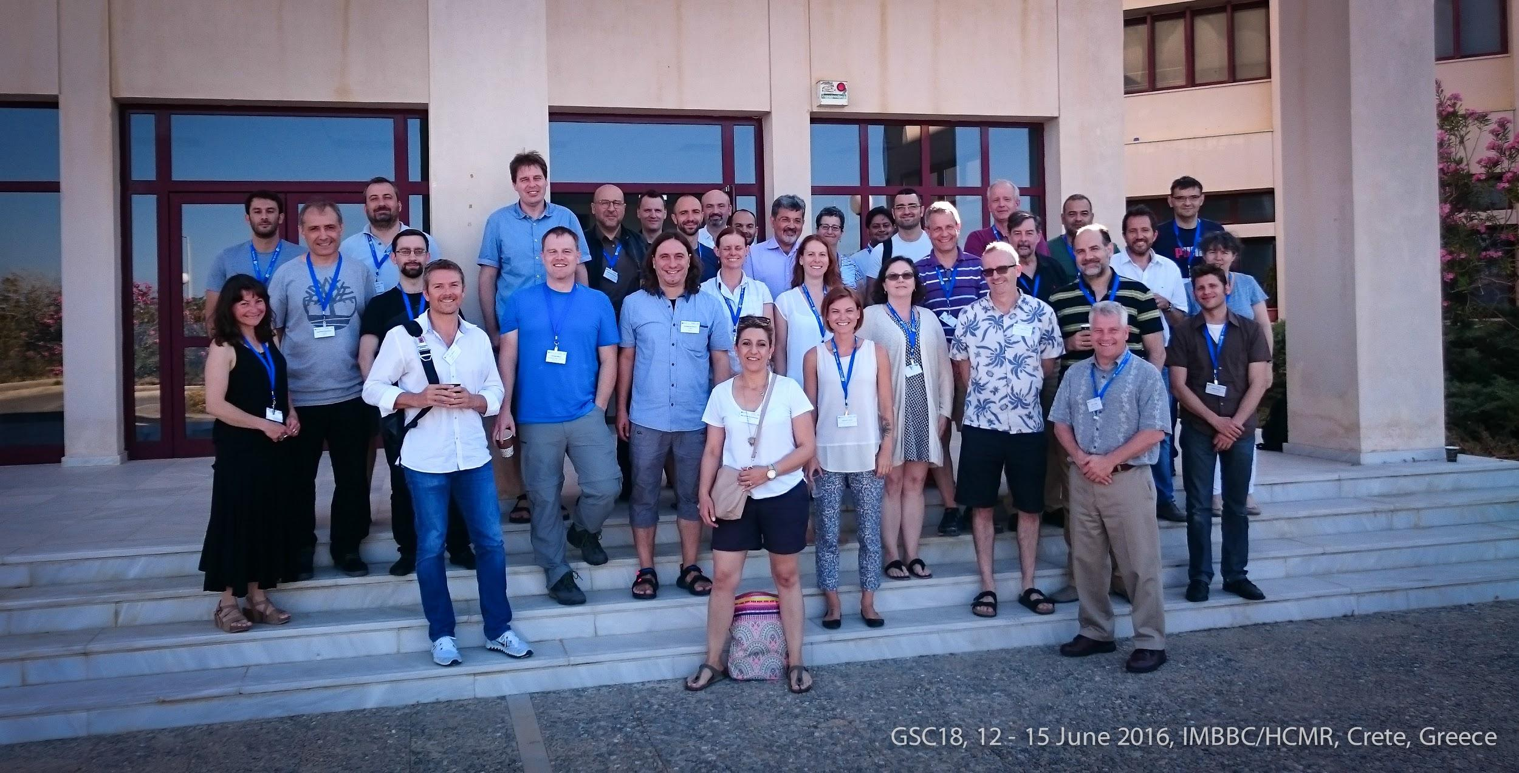
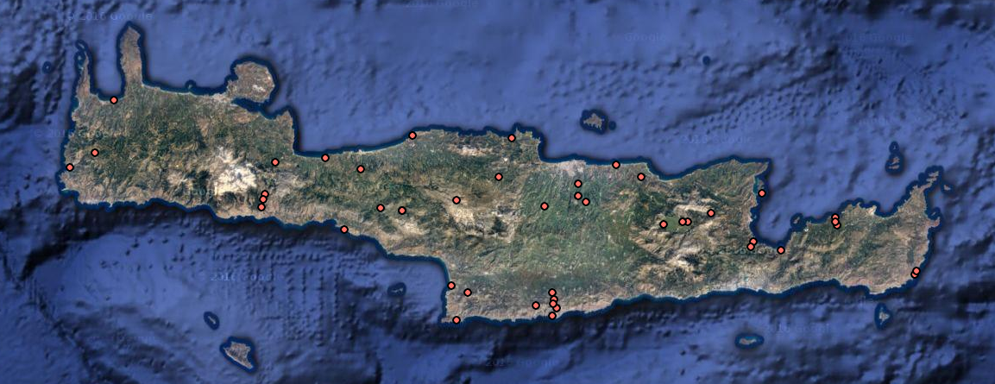
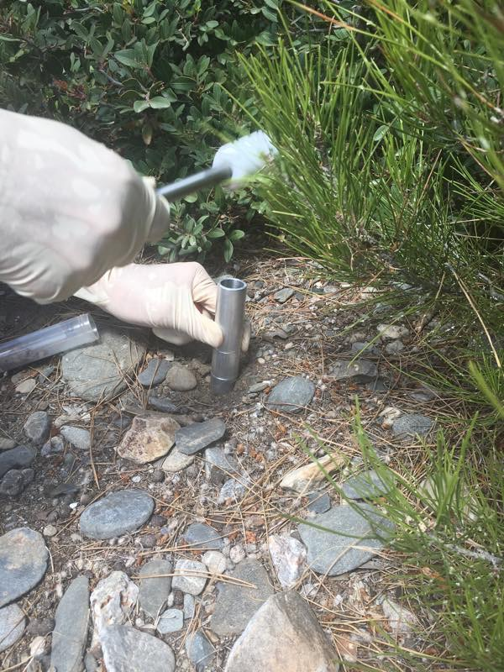
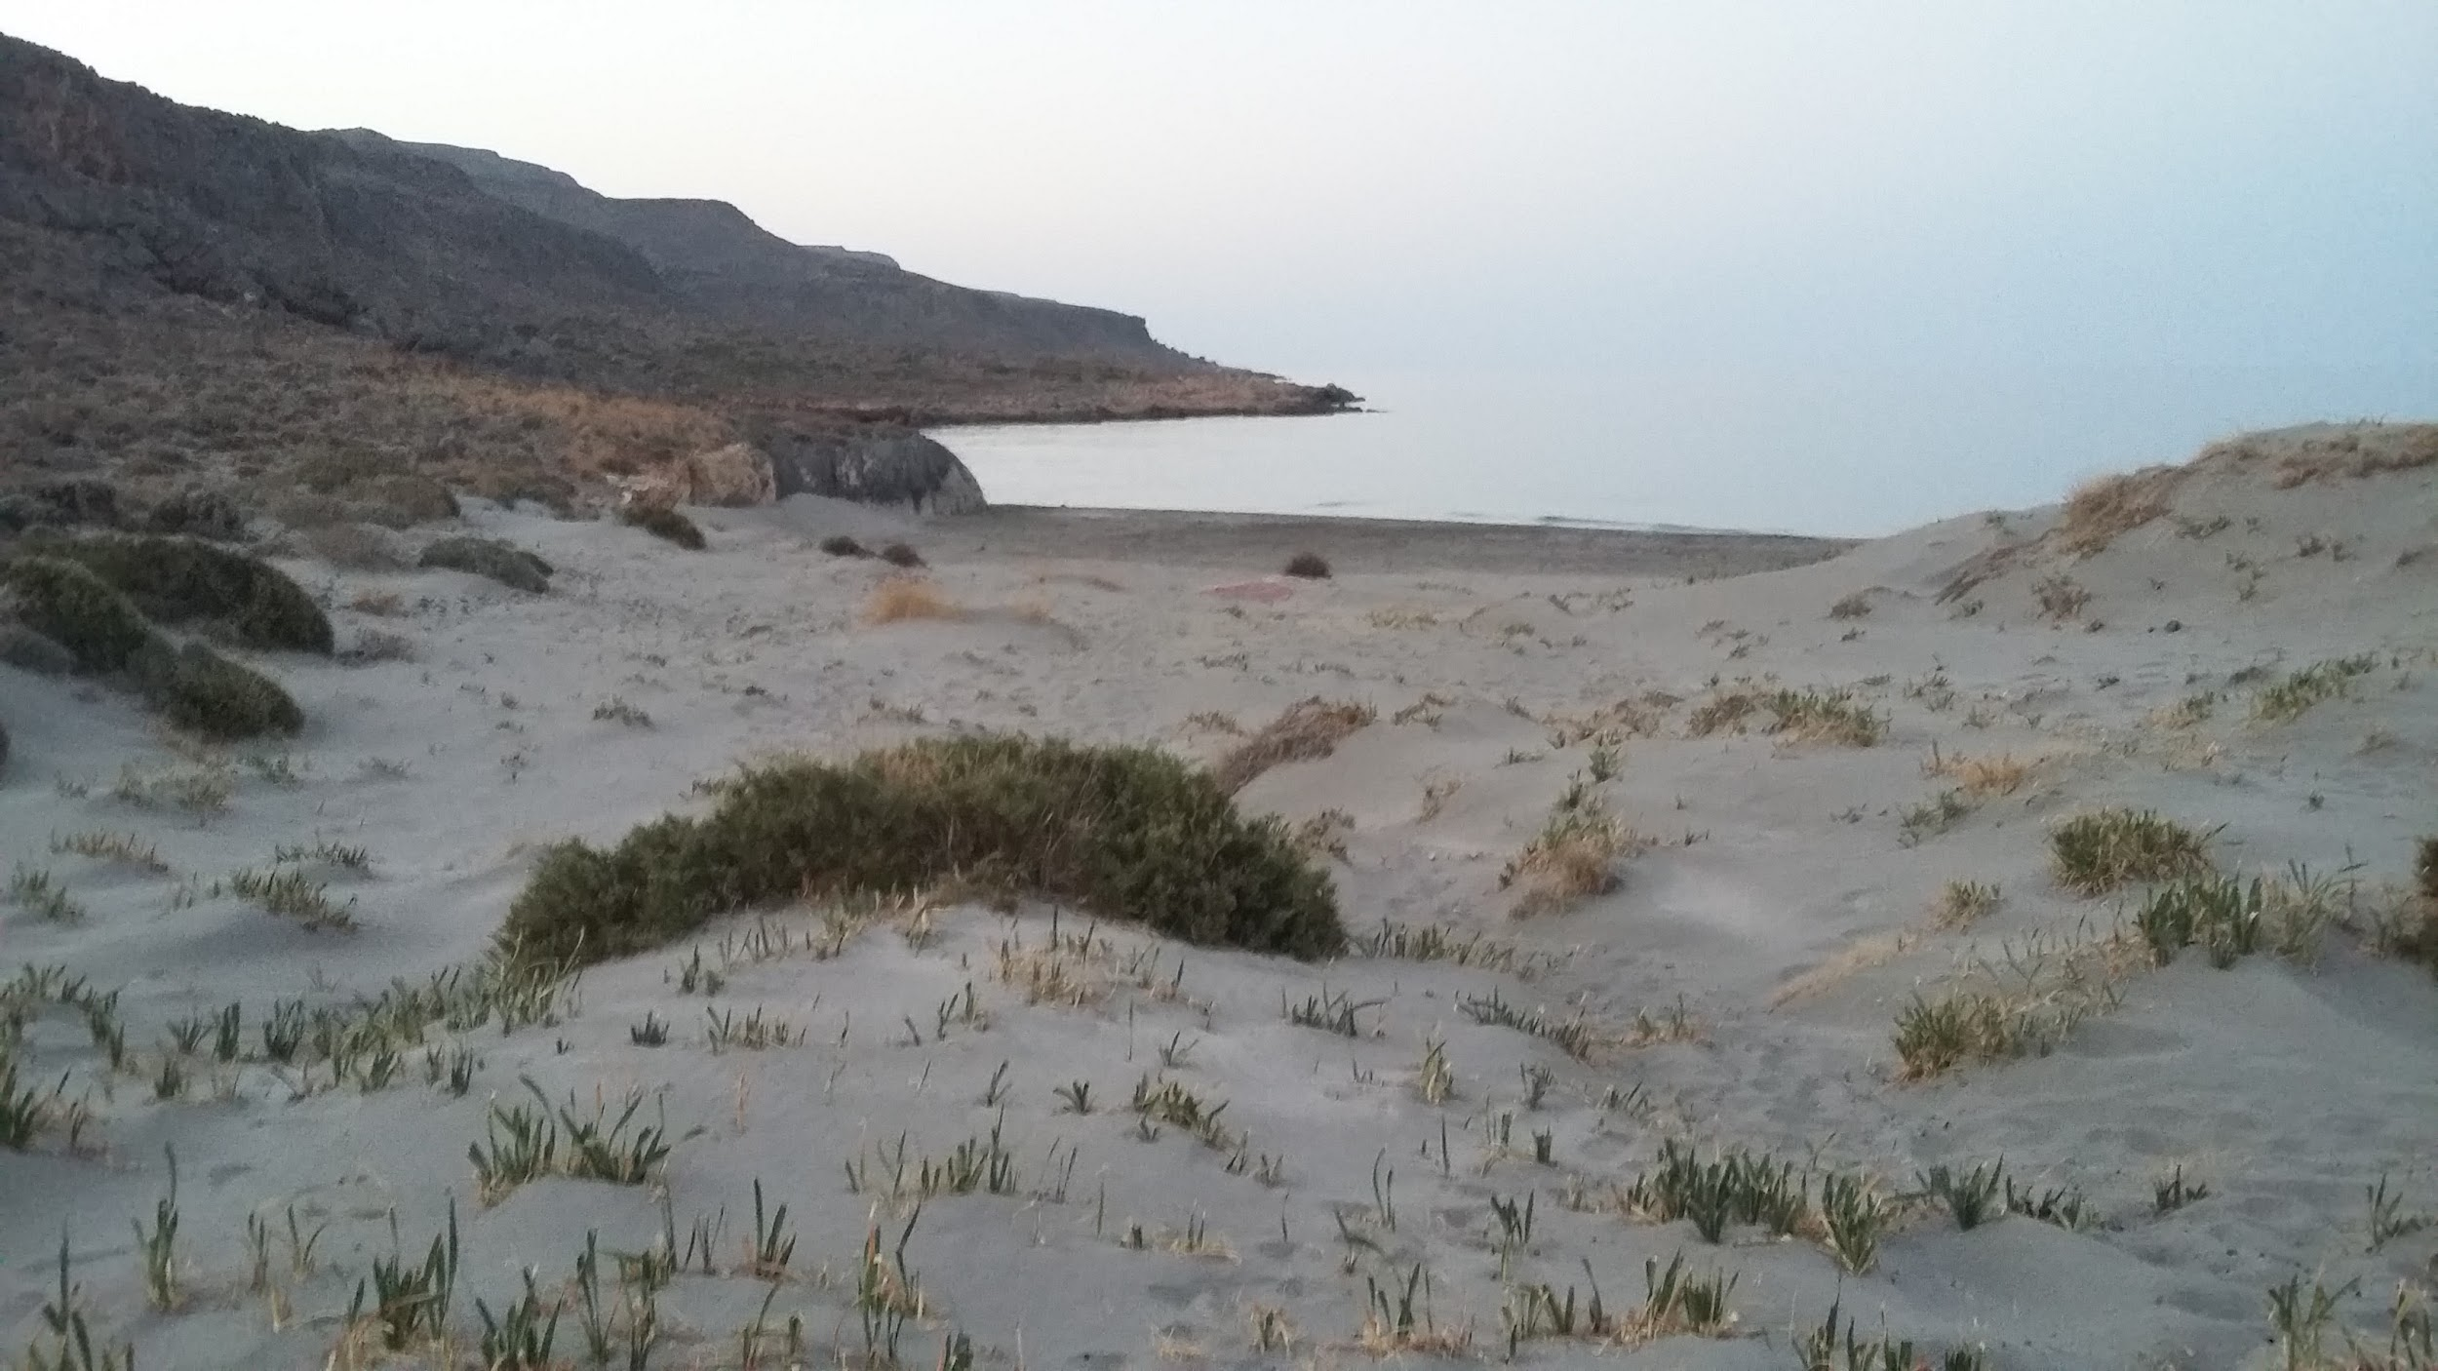
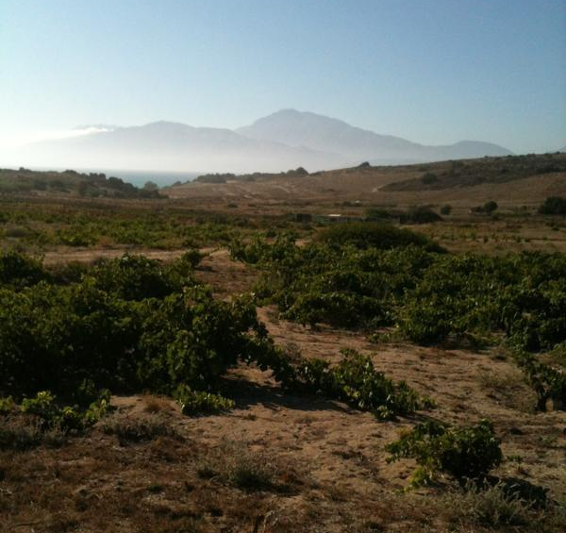
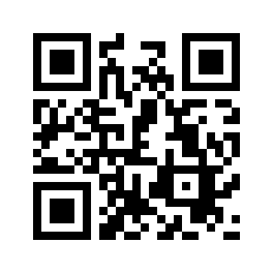





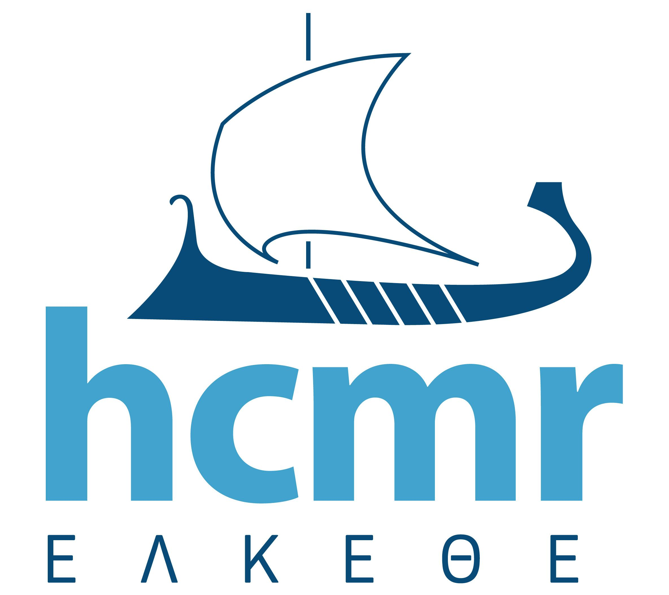
Evangelos Pafilis^{1*}, Melanthia Stavroulaki¹, Dimitris Tsaparis¹, Iraklis Vretzakis², Georgios Kotoulas¹, Antonios Magoulas¹, Lynn Schriml^{3*}, and the Genomics Standards Consortium Board, the 18th Genomics Standards Consortium workshop participants, the Crete Island Sampling Day 2016 participants.
¹ Institute of Marine Biology, Biotechnology and Aquaculture, Hellenic Centre for Marine Research, Heraklion, Crete, Greece, ² School of Biology, Aristotle University of Thessaloniki, Greece, ³ Institute for Genome Sciences, School of Medicine, University of Maryland, USA, Correspondence: pafilis@hcmr.gr, lschriml@som.umaryland.edu
18th Genomic Standards Consortium workshop
Crete Island Sampling Day 2016
Aim: to identify the functional composition of the microbes within metagenomic community associated with each vegetation type within and between each vegetation zone.
One Day, One Island - 15th June 2016, Crete
coordinated island wide Citizen Science activity
26 participants, 10 teams/routes
435 soil samples, 140 plant specimens
72 predefined locations across the island of Crete
different types of environments, elevations, vegetation and soil
a range of environmental and temporal variables recorded on site
On-going:
Marker gene and metagenomics analysis on soil samples
Plant specimens barcoding
Crete soil-associated-plant community assessment
The Genomic Standards Consortium (GSC) is an open-membership, international community aiming to enable genomic data integration, discovery and comparison [1].
The GSC18 workshop [2] held on 12 – 15 June 2016 at HCMR/IMBBC for the first time included an Island Sampling Day (ISD) event [3].
The main focus of the GSC18 meeting was to ‘put standards into action’.
Presentations to this end included both large-scale projects and resources, EBI/ENA [4], Ocean Sampling Day [5], Genomic Observatories [6], NEON [7], MetaSUB [8]), and smaller-scale focused projects (such as Moorea IDEA and microbiology activities in Greece).
Development of new standards and their application across research initiatives is an ongoing activity of the GSC.
As a response to the Nagoya protocol developments, part of the GSC18 meeting focused on new legislation pertinent to biological sampling and it’s impact on international scientific research studies.
3. Northwest Chania
1. Rethimno - Askyfou
9. Psiloritis Mt
5. Archanes
4. Lassithi - Richtis Gorge
8. Central South Rethimno
6. Lassithi Plateau
10. Xirokampos
7. Agiofaraggo - Kommos
2. Asterousia - Kofinas
A. Ten sampling areas were selected to examine the diverse and unique habitats and plants across the elevations on the island of Crete. Scientists attending the GSC18 meeting, HCMR staff and a group of local volunteers teamed up and headed out for a day of sampling
GSC18 ISD Movie
An introduction to GSC and the Crete Island Sampling Day as it evolved.
Directed by: Stavros Psyllakis
Filming Crew: Stella Christou, Michalis Geranios
Video: https://youtu.be/VpqIy7HDTd0 (~4 minutes)
High resolution versions available at [3] © HCMR/IMBBC 2016, CreteIDEA project
Scan to Watch!
B. Each team followed a standard sampling procedure, collecting three 50 mL Falcon tubes of soil at each site, recording GPS coordinates and sample site metadata including soil type, soil temperature, elevation, plant species, time and date of collection. From left to right: soil sampling device; Katsounaki beach, Xirokampos; Sivas lowlands - Kommos Beach transect
Acknowledgements
Resources
[1] Genomic Standards Consortium: http://gensc.org/
[2] 18th Genomic Standards Consortium workshop: http://wiki.gensc.org/index.php?title=GSC_18
[3] Crete Island Sampling Day: http://wiki.gensc.org/index.php?title=GSC_island_sampling_day
[4] EBI/ENA: http://www.ebi.ac.uk/ena
[5] Ocean Sampling Day: https://www.microb3.eu/osd
[6] Genomic Observatories: http://genomicobservatories.org/
[7] NEON: http://www.neonscience.org/
[8] MetaSUB: http://metasub.org/
Notes:
‹#›
‹#›

